Slide 1


“Promote peaceful and inclusive societies for sustainable development, provide access to justice for all and build effective, accountable and inclusive institutions at all levels”
Anti-Corruption Nepal
Hard Coders
-Binit K.C
-Krischal Khanal

Slide 2
As our main idea is to use technology to reduce corruption in Nepal.
So, we can use many programming languages to create many apps related to anti-corruption.
So, we used Flutter to create an app called Anti-Corruption Nepal which main task is to aware people about systems where probability of corruption is high and provide a medium to report about the corruption case which may include proofs such as text, photo, audio, video, etc.

Slide 3
Demonstration of our Anti-Corruption Nepal Beta Version Mobile Application

Slide 4
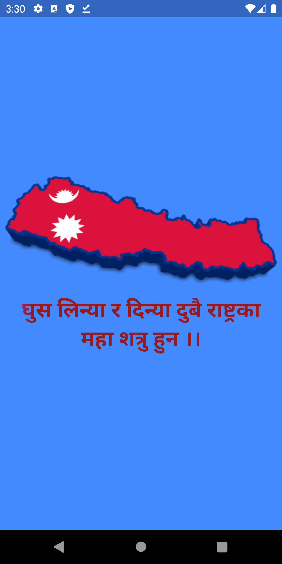
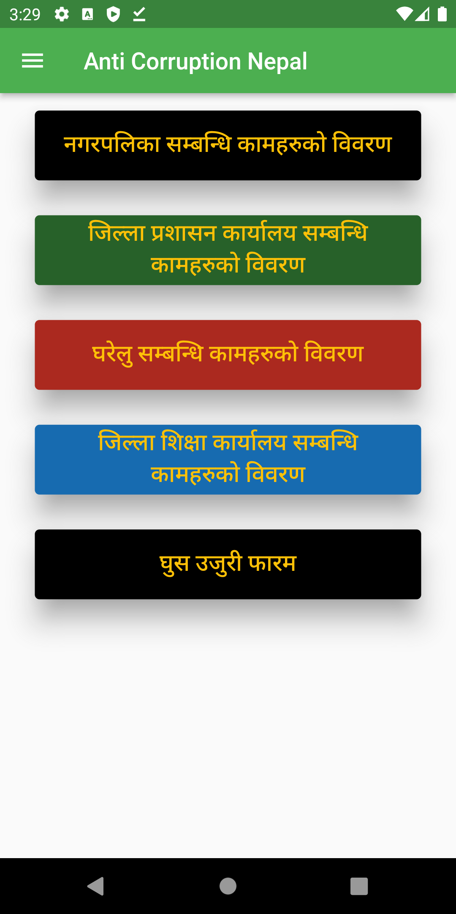
Loading Screen
Home Page

Slide 5
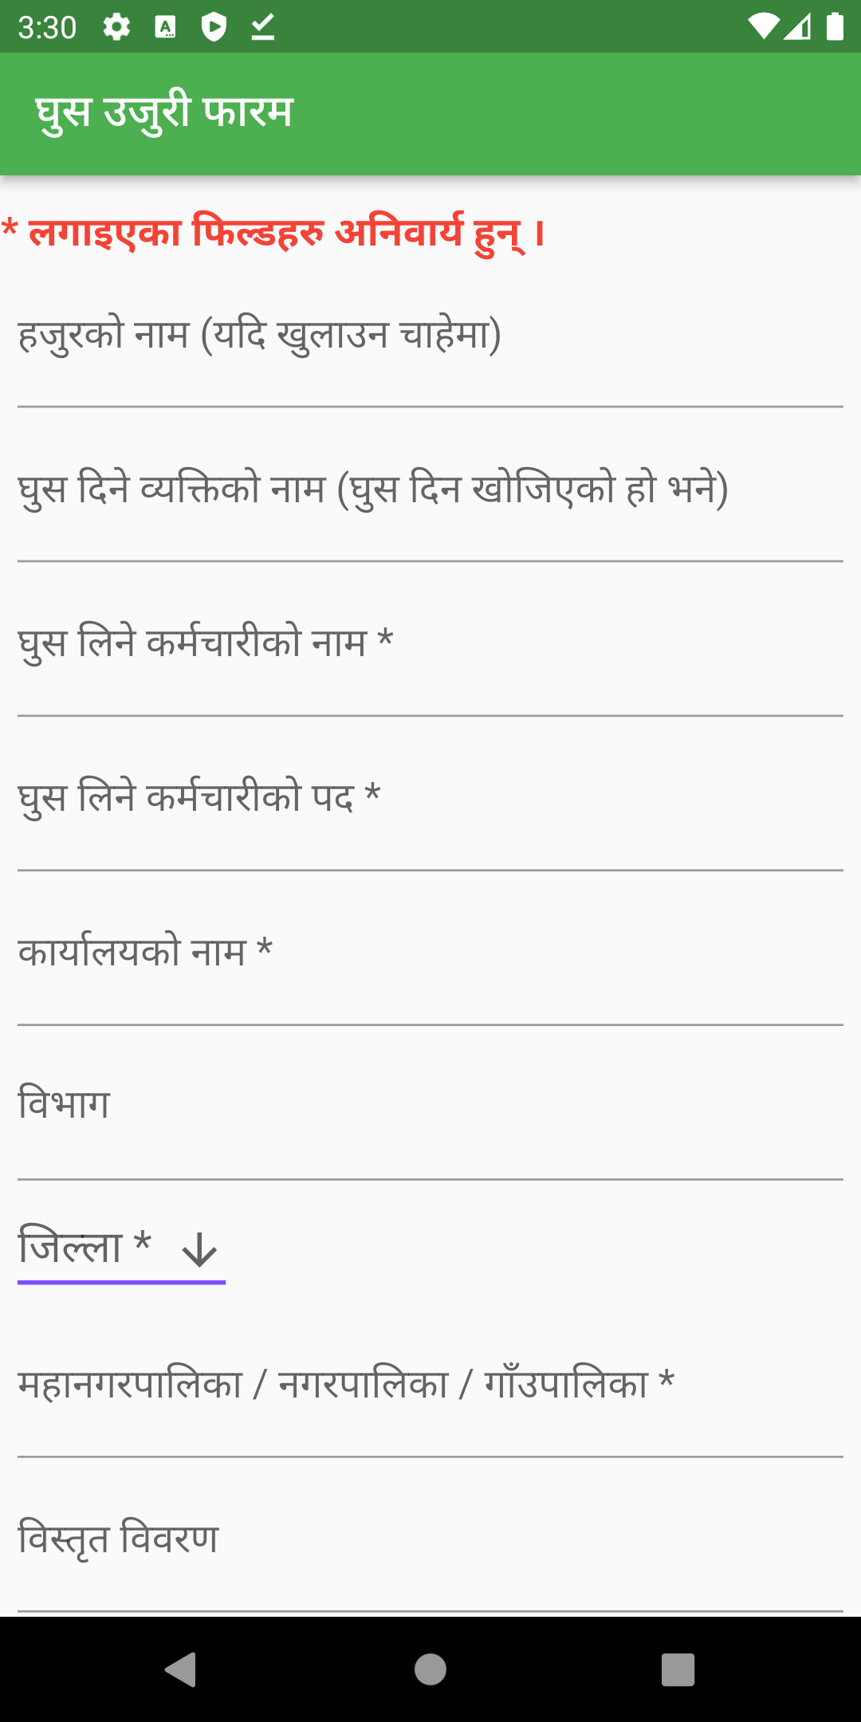
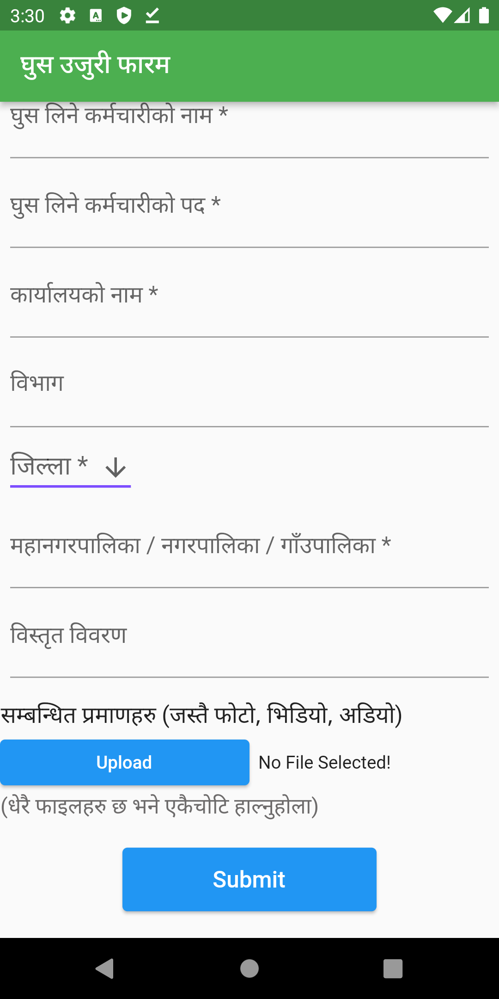
Form:

Slide 6
Impact due to our application
Before:

Slide 7
Thank You!

